Slide 1
From a Garden…

Slide 2
…To a City!
Hebrews 11: 8-10

Slide 3
OR
IS HEAVEN
UP OR DOWN?

Slide 4
Looking for a City, where we’ll never die, There the sainted millions never say goodbye, There we’ll meet our Savior, and our loved ones too, Come O Holy Spirit, all our hopes renew.
Hebrews 11: 8-10

Slide 5
WHERE WOULD YOU GO IF YOU DIED NOW?
The First Stop is UP!

Slide 6
1Cor. 2:9 But as it is written, Eye hath not seen, nor ear heard, neither have entered into the heart of man, the things which God hath prepared for them that love him.

Slide 7
1Cor. 2:10 But God hath revealed them unto us by his Spirit: for the Spirit searcheth all things, yea, the deep things of God.

Slide 8
WHERE WOULD YOU GO IF YOU DIED NOW?
The First Stop is UP!
But the First Stop is Temporary

Slide 9
2 Co 5:1 For we know that if our earthly house of this tabernacle were dissolved, we have a building of God, an house not made with hands, eternal in the heavens. 2 For in this we groan, earnestly desiring to be clothed upon with our house which is from heaven:

Slide 10
3 If so be that being clothed we shall not be found naked. 4 For we that are in this tabernacle do groan, being burdened: not for that we would be unclothed, but clothed upon, that mortality might be swallowed up of life.

Slide 11
Heb. 2:14 Forasmuch then as the children are partakers of flesh and blood, he also himself likewise took part of the same; that through death he might destroy him that had the power of death, that is, the devil; 15 And deliver them who through fear of death were all their lifetime subject to bondage.

Slide 12
WHERE WILL WE BE AFTER THAT?
The Second Stop is Down

Slide 13
Rev. 6:9 And when he had opened the fifth seal, I saw under the altar the souls of them that were slain for the word of God, and for the testimony which they held: 10 And they cried with a loud voice, saying, How long, O Lord, holy and true, dost thou not judge and avenge our blood on them that dwell on the earth?

Slide 14
Rev. 6:11 And white robes were given unto every one of them; and it was said unto them, that they should rest yet for a little season, until their fellowservants also and their brethren, that should be killed as they were, should be fulfilled.

Slide 15
WHERE WILL WE BE AFTER THAT?
The Second Stop is Down
(The New Earth is Our Final Destination – Rev. 21:1-4)

Slide 16
2 Pet. 3:10 But the day of the Lord will come as a thief in the night; in the which the heavens shall pass away with a great noise, and the elements shall melt with fervent heat, the earth also and the works that are therein shall be burned up.

Slide 17
2 Pet. 3:12 Looking for and hasting unto the coming of the day of God, wherein the heavens being on fire shall be dissolved, and the elements shall melt with fervent heat. 13 Nevertheless we, according to his promise, look for new heavens and a new earth, wherein dwelleth righteousness.

Slide 18
It is no coincidence that the first 2 chapters of the Bible begin with the creation of the heavens and the earth and the last 2 chapters begin with the recreation of the heavens and the earth.

Slide 19
1Co 15:42 So also is the resurrection of the dead. It is sown in corruption; it is raised in incorruption: 43 It is sown in dishonour; it is raised in glory: it is sown in weakness; it is raised in power: 44 It is sown a natural body; it is raised a spiritual body. There is a natural body, and there is a spiritual body.

Slide 20
Phil. 3:20 For our conversation is in heaven; from whence also we look for the Saviour, the Lord Jesus Christ: 21 Who shall change our vile body, that it may be fashioned like unto his glorious body, according to the working whereby he is able even to subdue all things unto himself.

Slide 21
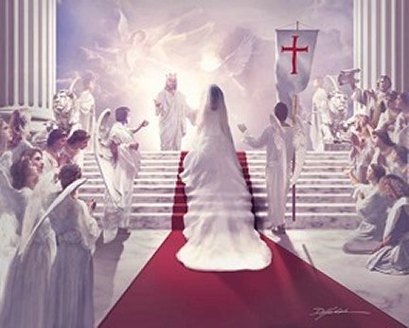
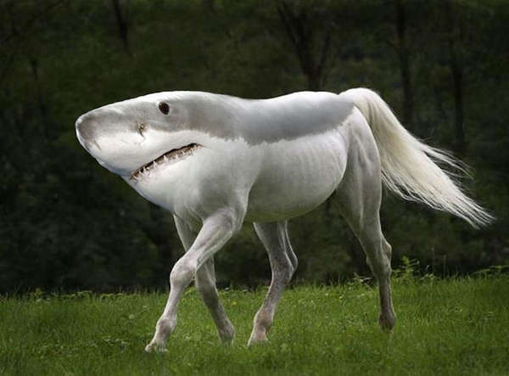
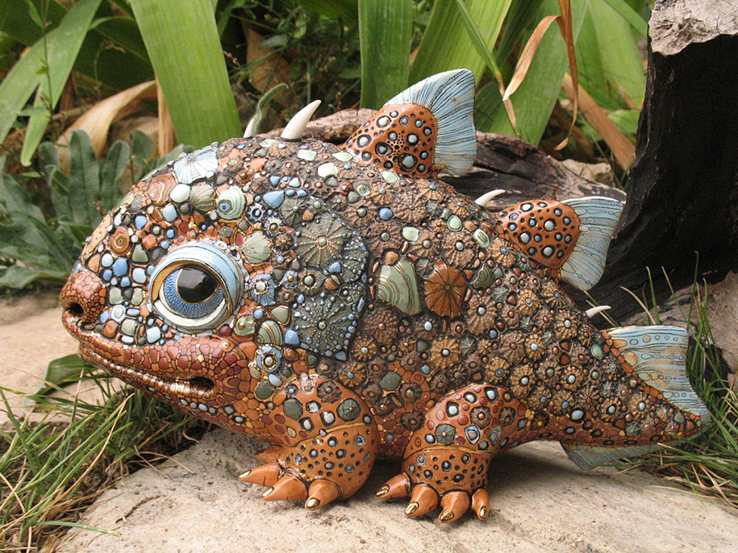
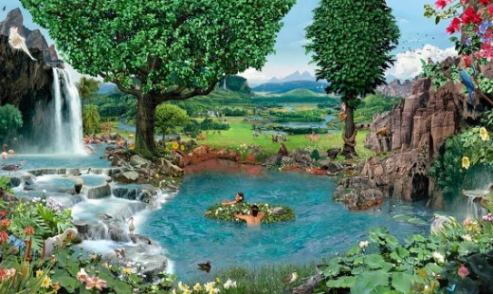

Slide 22
WHERE WILL WE BE AFTER THAT?
The Second Stop is Down
The Second Stop is the New Earth & it is Permanent

Slide 23
Change #1 = SALVATION
Change #2 = DEATH
Change #3 = RESURRECTION
(Glorification)

Slide 24
IS “HEAVEN”
UP OR DOWN?
IT IS BOTH!

Slide 25
IS “HEAVEN”
UP OR DOWN?
IT IS BOTH!
WILL YOU BE THERE?
HOW ABOUT YOUR LOVED ONES?

