Slide 1
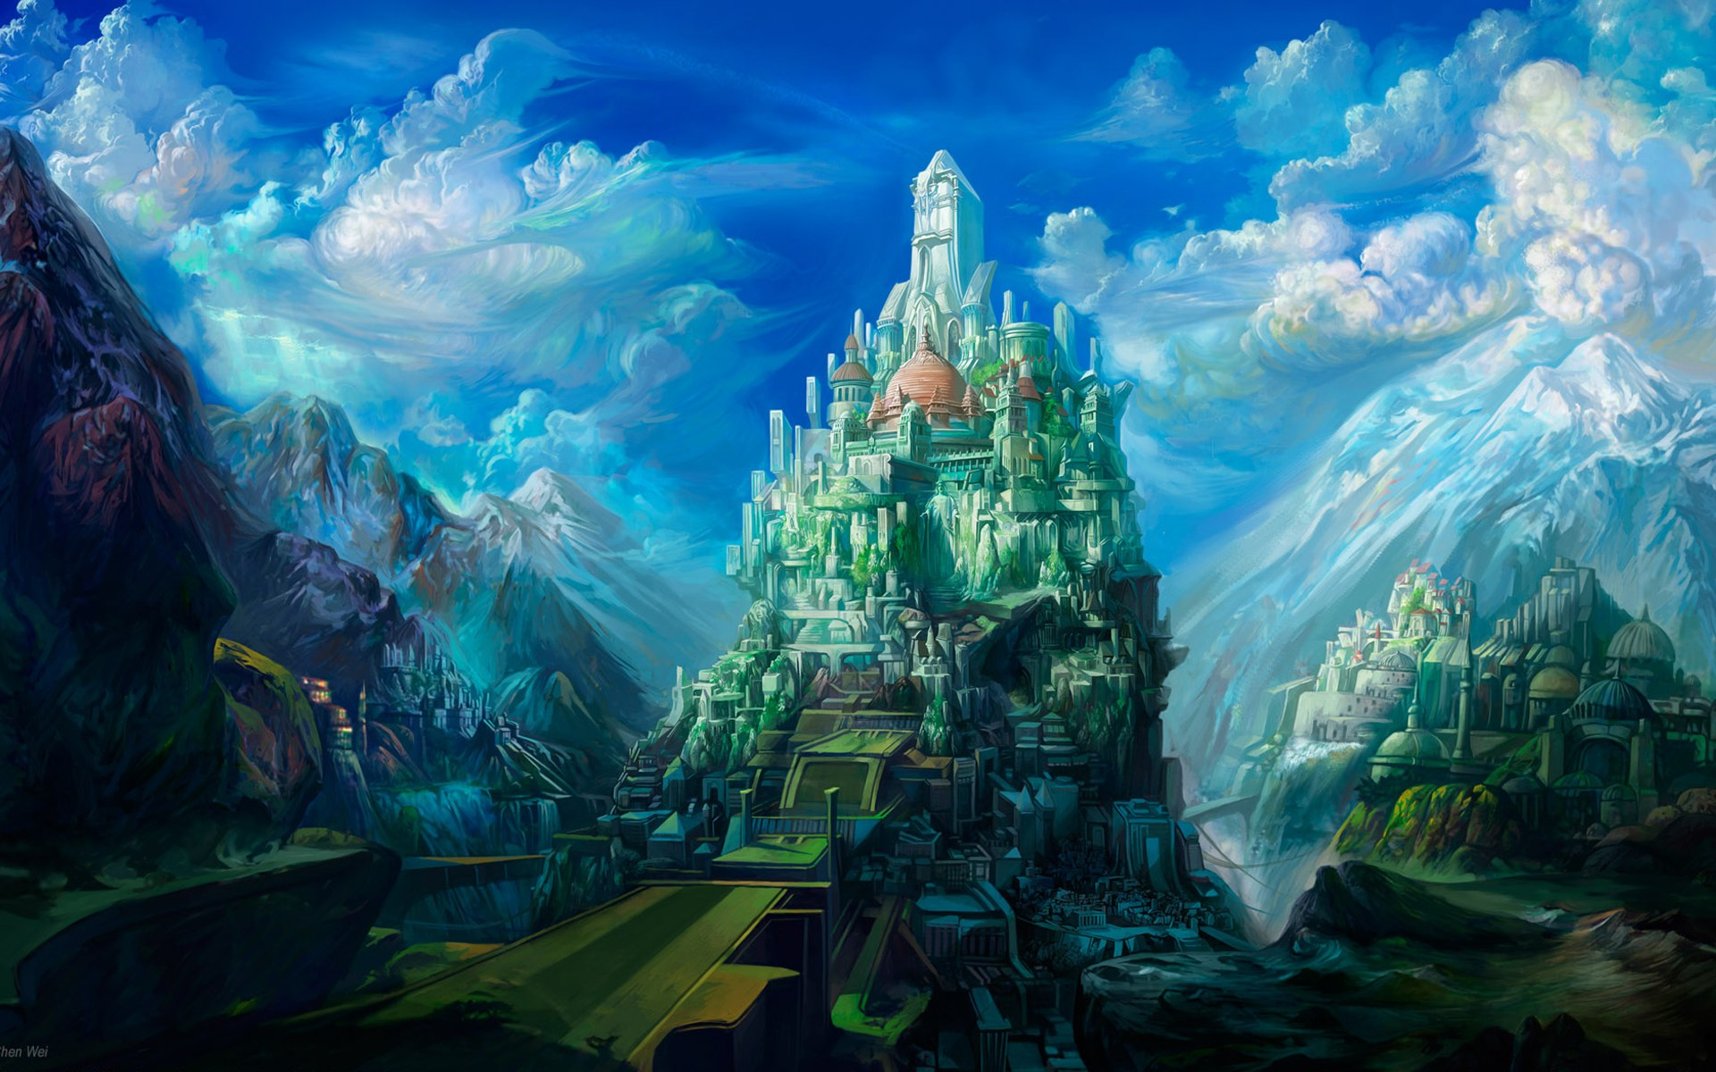
HEAVEN ON EARTH SUNDAY

Slide 2
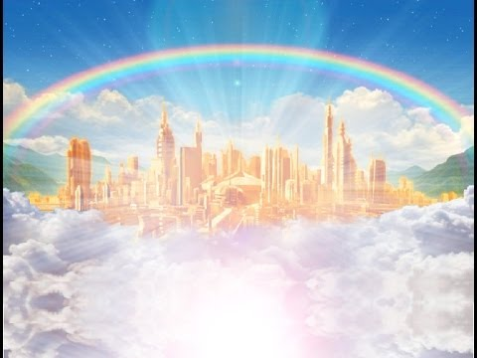
IT’S ALL ABOUT HEAVEN – AND YOU! AND…

Slide 3
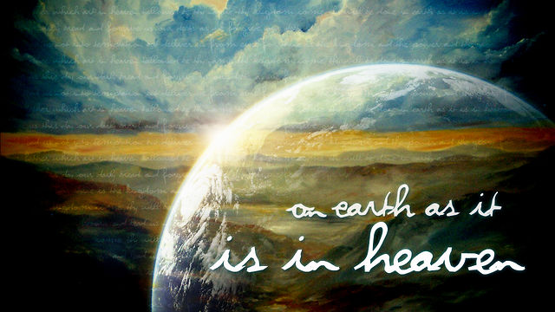
…HEAVEN ON EARTH Genesis 2:7-15

Slide 4
“Eden” = “pleasantness”
HEAVEN ON EARTH!

Slide 5
“Heaven” is NOT “Heavenly” They are NOT the same, they are opposites.
HEAVEN ON EARTH!

Slide 6
“Heaven” is a literal, physical, material PLACE – just like Eden!
HEAVEN ON EARTH!

Slide 7
The Kingdom of Heaven is an earthly, literal, physical Kingdom of 1000 years duration.
(Almost) HEAVEN ON EARTH!

Slide 8
Rom. 8 :22,23
For we know that the whole creation groaneth and travaileth in pain together until now. And not only they, but ourselves also, waiting for the adoption, to wit, the redemption our our body.

Slide 9
THE NEW EDEN:
Eden Restored

Slide 10
God’s promise: Isaiah 51:3
For the Lord shall comfort Zion: He will comfort all her waste places; and he will make her wilderness like Eden, and her desert like the garden of the Lord; joy and gladness shall be found therein, thanksgiving, and the voice of melody.

Slide 11
Isaiah 51:6
Lift up your eyes to the heavens, and look upon the earth beneath: for the heavens shall vanish away like smoke, and the earth shall wax old like a garment…

Slide 12
Acts 3:20,21
And he shall send Jesus Christ, which before was preached unto you: Whom the heaven must receive until the times of restitution of all things, which God hath spoken by the mouth of all his holy prophets since the world began.

Slide 13
“…God’s ultimate plan is not to take us up to live in a realm made for Him, but to come down and live with us in the realm He made for us.” “HEAVEN”: - Randy Alcorn

Slide 14
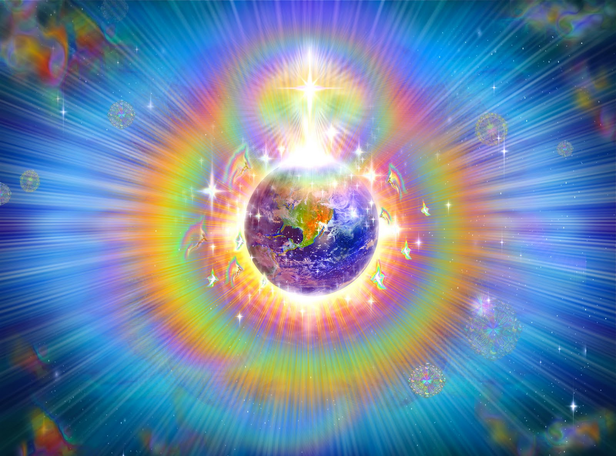
THE NEW EARTH:

Slide 15
2 Peter 3:13
Nevertheless we, according to His promise, look for new heavens and a new earth wherein dwelleth righteousness.

Slide 16
Romans 8:23
“…the whole creation groaneth and travaileth in pain together until now.
And not only they, but ourselves also, waiting for the adoption, to wit, the redemption of our body.”

Slide 17
THE NEW EARTH:
The Original Earth
(God’s Template for Heaven on earth)
The Present Earth
The New Earth

Slide 18
Revelation 21:1-3
And I saw a new heaven and a new earth: for the first heaven and the first earth were passed away; and there was no more sea. And I John saw the holy city, new Jerusalem, coming down from God out of heaven, prepared as a bride adorned for her husband.

Slide 19
Revelation 21:1-3
And I heard a great voice out of heaven saying, Behold, the tabernacle of God is with men, and he will dwell with them, and they shall be his people, and God himself shall be with them, and be their God.

Slide 20
Ephesians 1:10,11
That in the dispensation of the fulness of times He might gather together in one all things in Christ, both which are in heaven, and which are on earth; even in Him: in Whom we have obtained an inheritance…

Slide 21
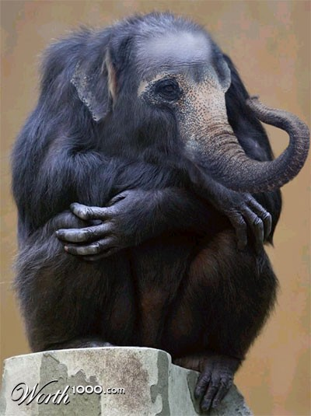
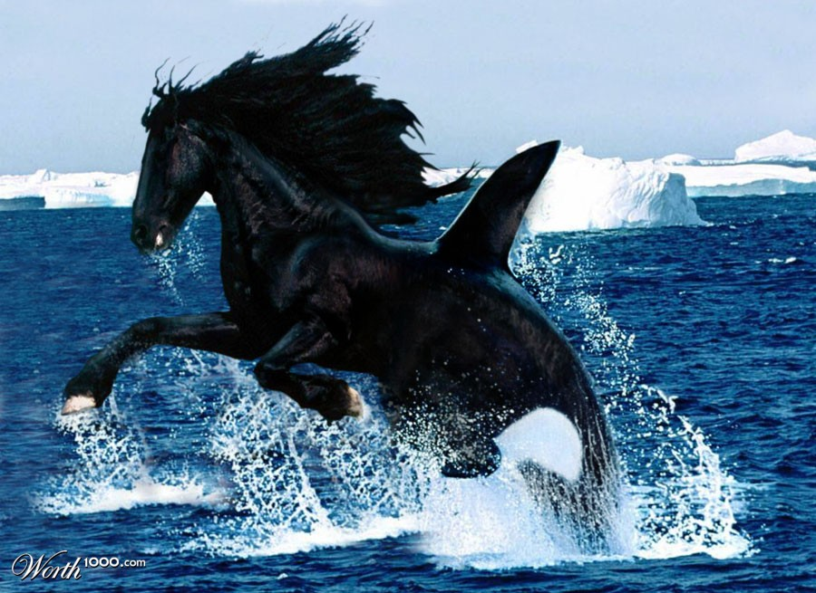
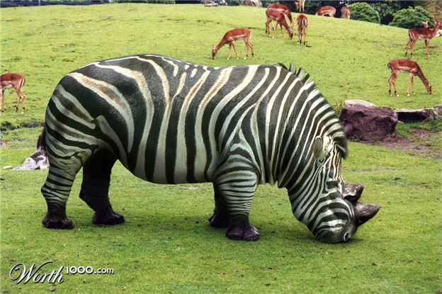

Slide 22
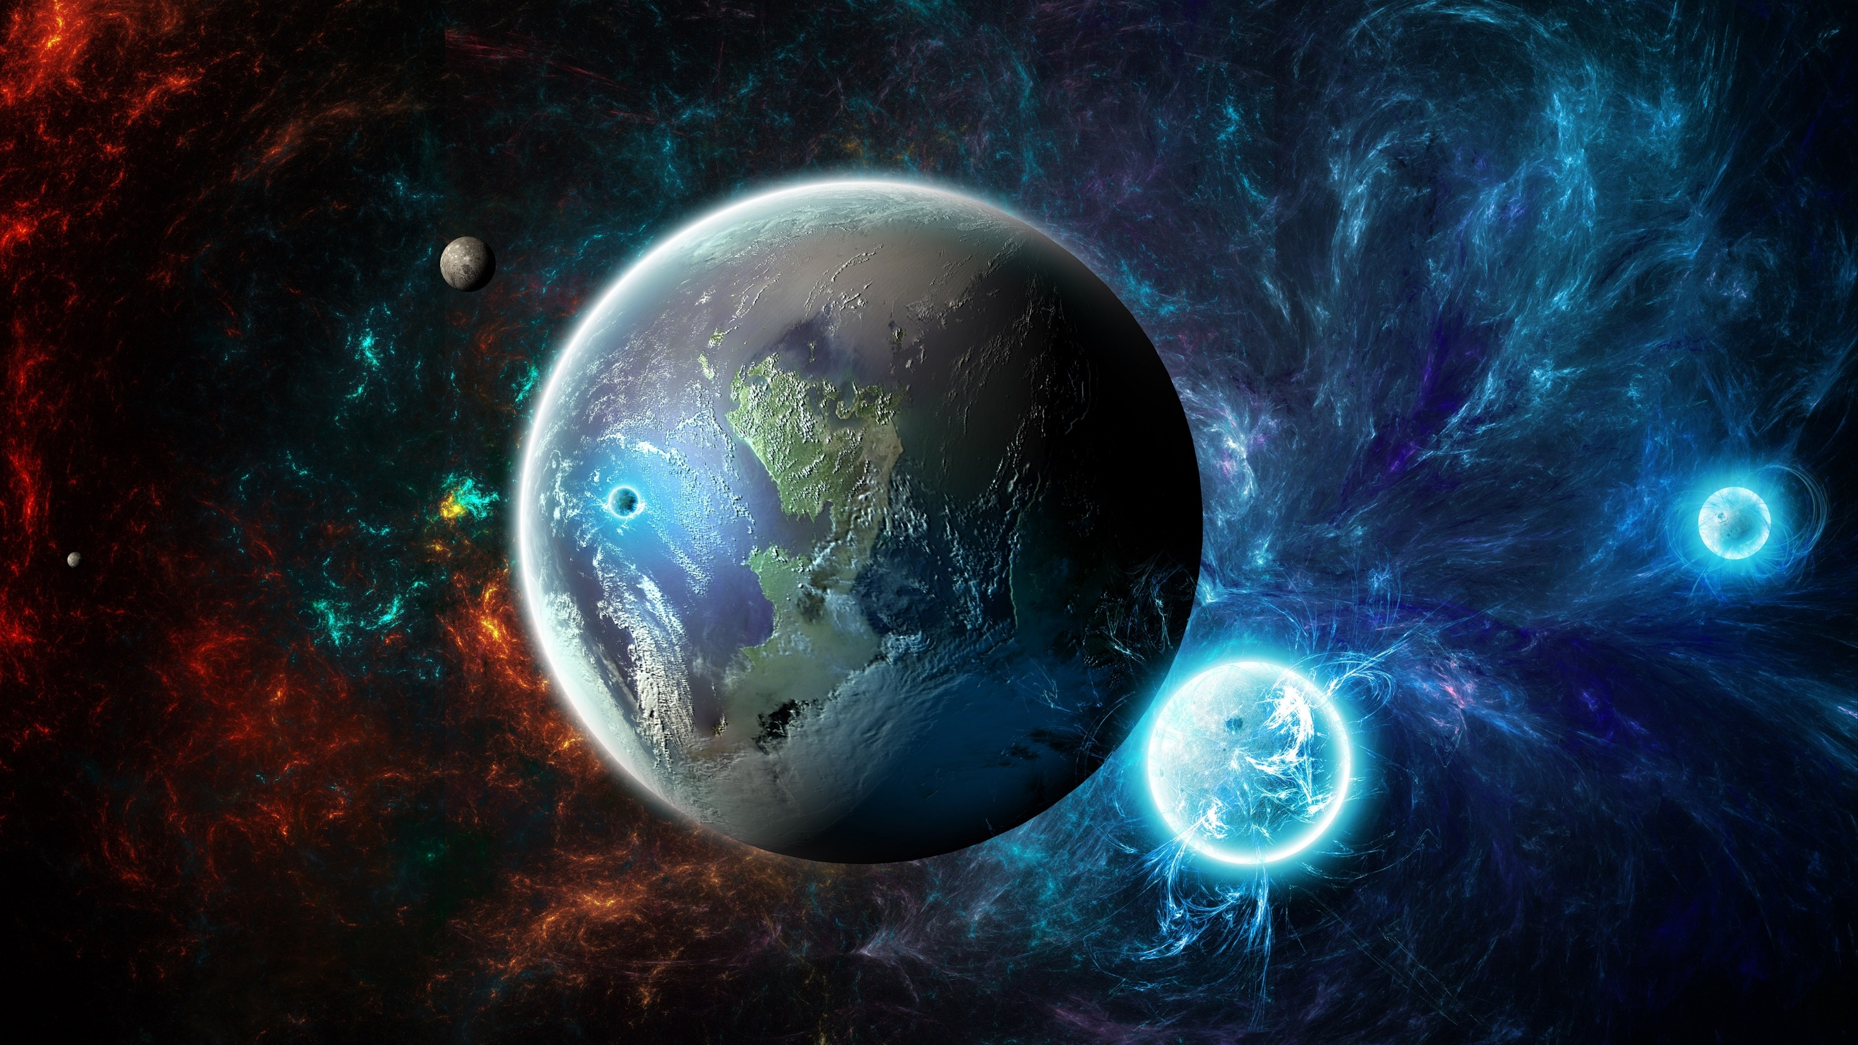
HEAVEN IS WHEREVER GOD DWELLS… Rev. 21:1-3

Slide 23
HEAVEN IS WHEREVER GOD DWELLS…
God will dwell with His people on the New Earth – HEAVEN ON EARTH!

Slide 24
HEAVEN IS WHEREVER GOD DWELLS…
I am looking forward to being with Him forever on His New Creation, in His New Universe, in the New Jerusalem with the focal point being the New Earth!

Slide 25
HEAVEN IS WHEREVER GOD DWELLS…
Won’t you join me?!

Slide 26
“This is my Father’s World” v.3 1858
“Jesus Who died will be satisfied, and earth and Heaven be one.”

Slide 27
HEAVEN ON EARTH

