Slide 1
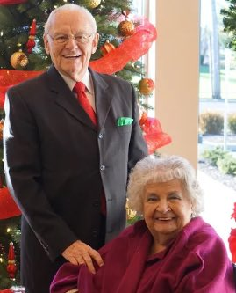
“What is Shirley doing now?”
2 Cor. 5:1-11

Slide 2
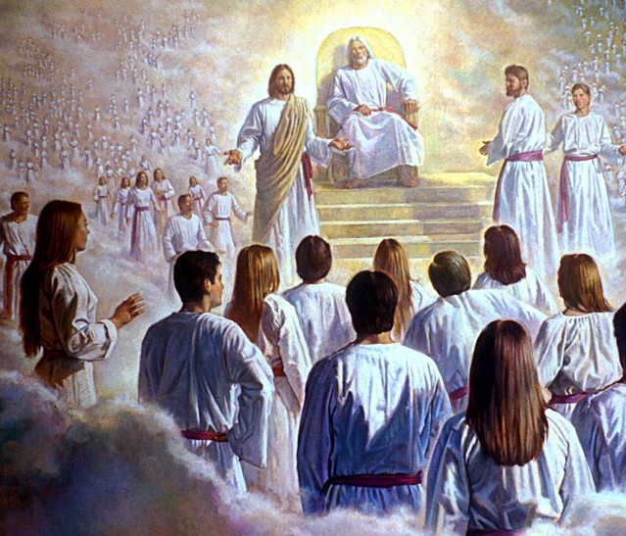
“What are YOUR loved ones doing now?”
2 Cor. 5:1-11

Slide 3
What is Shirley Like NOW?
She is NOT an Angel!
(Angels do not have wings)
(Angels are male)

Slide 4
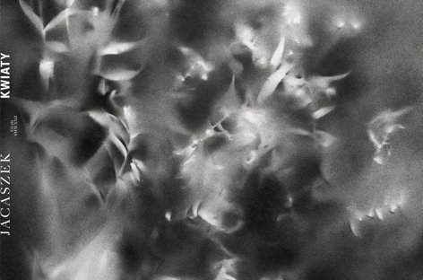
What is Shirley Like NOW?
She does not have a glorified body yet!
(But she is NOT some
formless blob!)

Slide 5
1 Cor. 15:53,54 For this corruptible must put on incorruption, and this mortal must put on immortality. So when this corruptible shall have put on incorruption, and this mortal shall have put on immortality, then shall be brought to pass the saying that is written, Death is swallowed up in victory. (Glorfication)

Slide 6
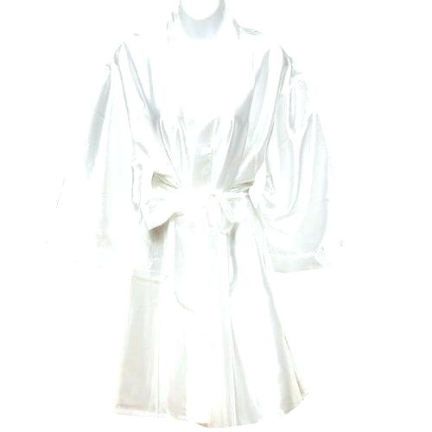
What is Shirley Like NOW?
She has what I will call
an “Intermediate Body”
(A God-fashioned body)

Slide 7
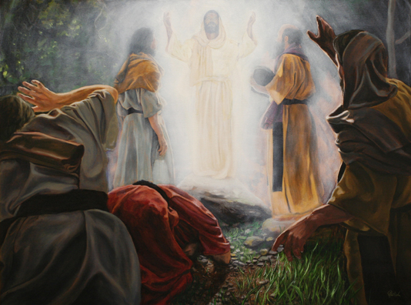

Slide 8
Where is Shirley NOW?
In Heaven: “present with the Lord” v.8
With Her Creator & Savior:
Ps. 148-50

Slide 9
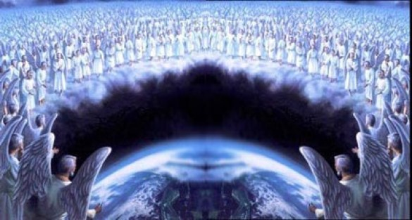
What is Shirley Doing Now?
Watching?

Slide 10
Heb 12:1 Wherefore seeing we also are compassed about with so great a cloud of witnesses, let us lay aside every weight, and the sin which doth so easily beset us, and let us run with patience the race that is set before us…

Slide 11
What is Shirley Doing Now?
Watching?
Waiting
…on us?
…on the Rapture?
…on the Judgment Seat?
…on her new glorified body?!

Slide 12
What is Shirley Doing Now?
Watching?
Waiting?
Working (Serving!)
(All we will do will please Him…Finally!

Slide 13
“What is Shirley doing now?”
2 Cor. 5:1-11

Slide 14
“What are YOUR loved ones doing now?”
2 Cor. 5:1-11

Slide 15
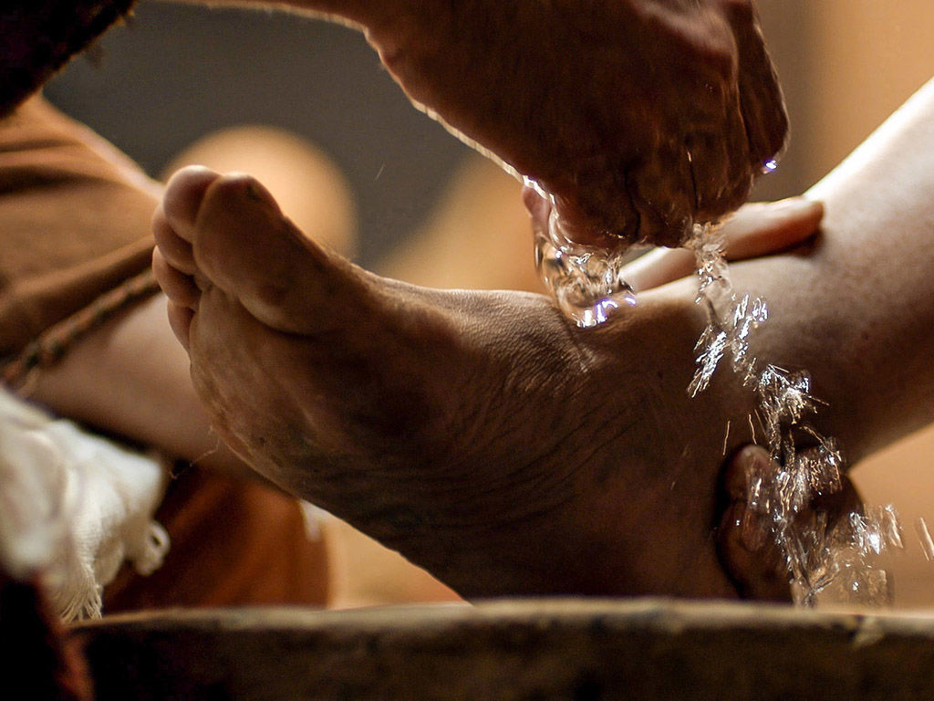
What are WE doing NOW to serve our Savior?

