Slide 1
PILLARS OF THE FAITH
#1 – Assurance of Salvation
#5 – Prayers of
the Blessed
#2 – Society of the
Saved (Church)
#6 – Destiny of the Damned
#3 – Separation of the Saints
#7 – Sanctuary of the Saints
#4 – Priesthood
of the Believer

Slide 2
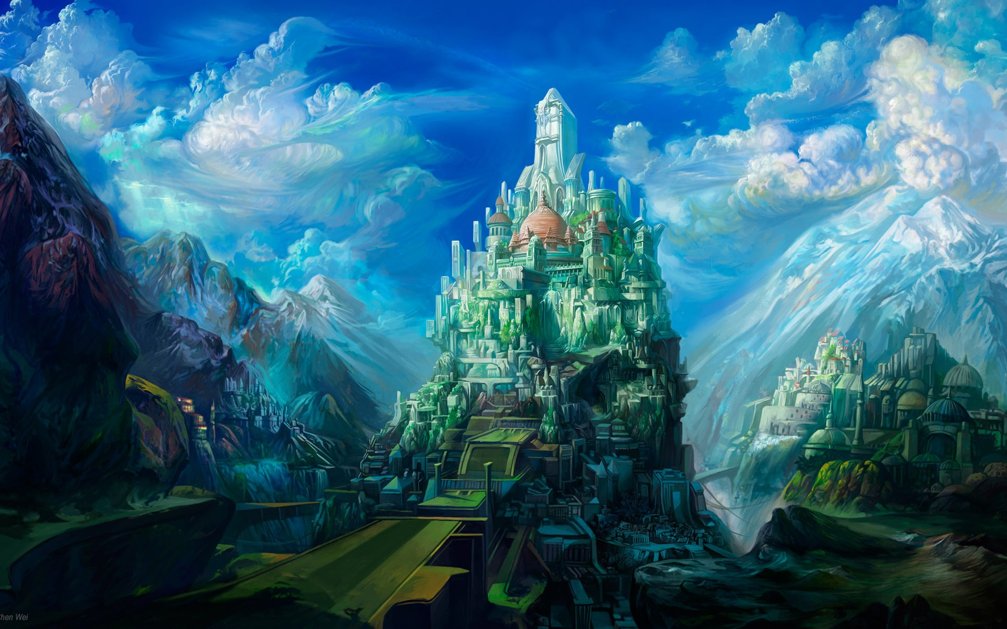
HEAVEN ON EARTH SUNDAY

Slide 3
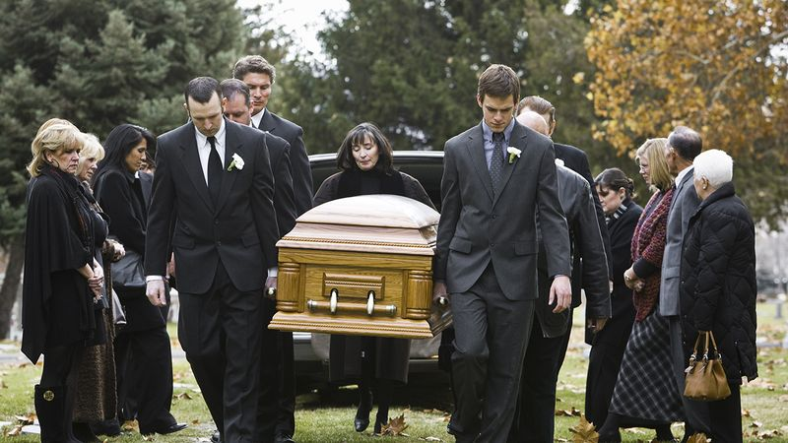
YOUR FUNERAL AND WHAT FOLLOWS
Hebrews 9:27; 2 Cor. 5:8-10

Slide 4
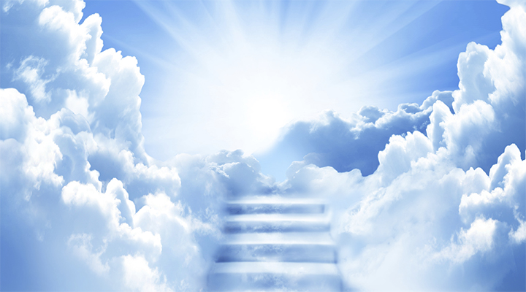
Just think of stepping on shore-
And finding it Heaven! Of touching a hand-
And finding it God's! Of breathing new air-
And finding it celestial! Of waking up in glory-
And finding it home!

Slide 5
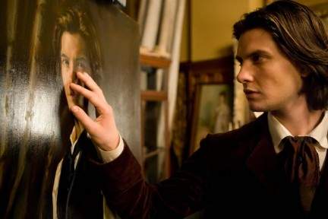
“A Portrait of Dorian Gray” 1891

Slide 6
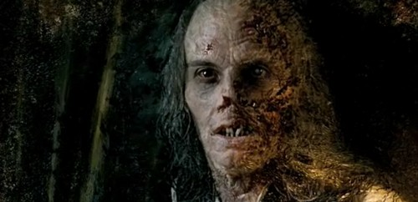
What we are becoming here will determine what we will be in the future.
We are projecting an image into eternity!

Slide 7
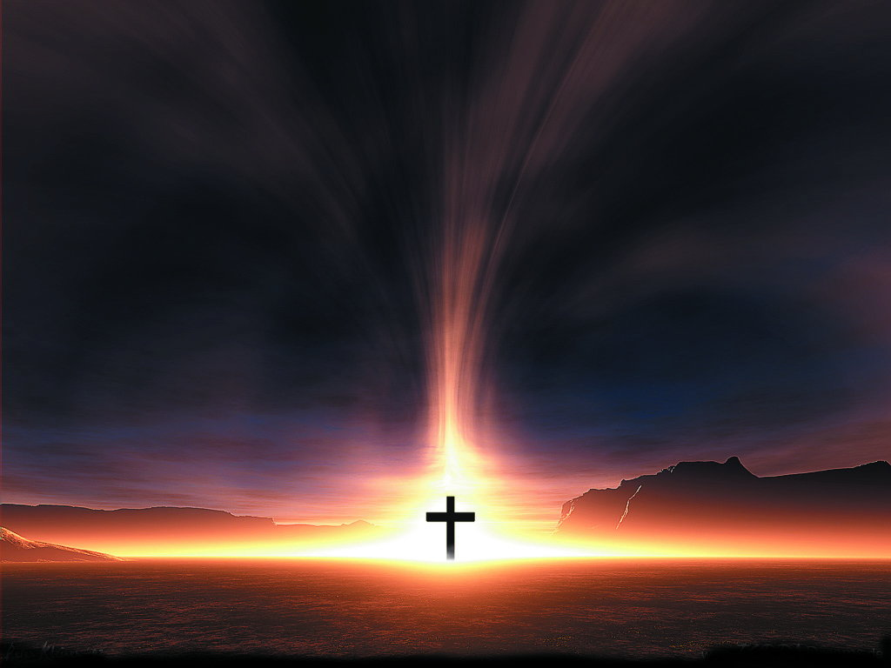
YOUR FUNERAL AND WHAT FOLLOWS…
WHERE WE WILL BE IS FREE:
What the Salvation Package Includes
Heaven
Eternal life
Sonship
Righteousness
Forgiveness
Holy Spirit
Authority
Inheritance

Slide 8
YOUR FUNERAL AND WHAT FOLLOWS…
WHERE WE WILL BE IS FREE:
What the Salvation Package Doesn’t Include:
Obedience
Maturity
Faithfulness

Slide 9
“And that He died for all, that they which live should not henceforth live unto themselves, but unto Him which died for them, and rose again. 2 Cor. 5:15

Slide 10
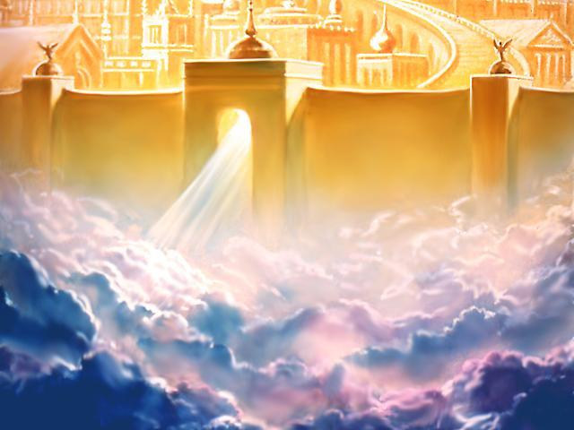
YOUR FUNERAL AND WHAT FOLLOWS…
WHAT WE WILL BE LIKE IS DEVELOPED:
We Cannot Avoid the Conse-quences of a Wasted Life
Loss here: reputation, testimony, joy, peace…

Slide 11
YOUR FUNERAL AND WHAT FOLLOWS…
WHAT WE WILL BE LIKE IS DEVELOPED: We Cannot Avoid the Conse-quences of a Wasted Life
Loss there: rewards, position, reign…

Slide 12
YOUR FUNERAL AND WHAT FOLLOWS…
WHAT WE WILL BE LIKE IS DEVELOPED:
We Cannot Avoid the Consequences of a Wasted Life
We Cannot Be Something in Heaven We Never Were on Earth

Slide 13
“For other foundation can no man lay than that is laid, which is Jesus Christ. Now if any man build upon this foundation gold, silver, precious stones, wood, hay stuble; Every man’s work shall be made manifest: for the day shall declare it…

Slide 14
“ …because it shall be revealed by fire; and the fire shall try every man’s work of what sort it is. If any man’s work abide which he hath built thereupon, he shall receive a reward. If any man’s work shall be burned, he shall suffer loss: but he himself shall be saved; yet so as by fire.” 1 Cor. 3:11-15

Slide 15
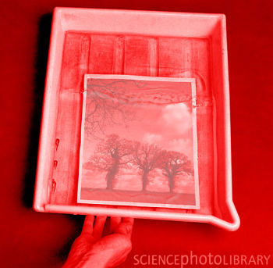
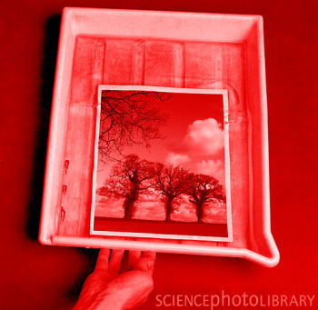
DEVELOPING STAGE
(LIFE)
FIXING STAGE
(DEATH)
DISPLAY STAGE
(HEAVEN)
“That in the ages to come He might shew the exceeding riches of His grace in His kindness toward us through Christ Jesus.” Eph. 2:7

Slide 16
DEVELOPING STAGE
(LIFE)
FIXING STAGE
(DEATH)
DISPLAY STAGE
(HEAVEN)
“And they that be wise shall shine as the brightness of the firmament; and they that turn many to righteousness as the stars for ever and ever.” Daniel 12:3

Slide 17
YOUR FUNERAL AND WHAT FOLLOWS…
WHAT WE WILL BE LIKE IS DEVELOPED:
We Cannot Avoid the Conse-quences of a Wasted Life
We Cannot Be Something in Heaven We Never Were on Earth

Slide 18
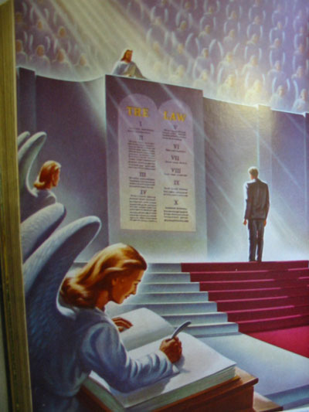
YOUR FUNERAL AND WHAT FOLLOWS…
WHAT WE WILL DO IS EARNED:
We Must Be Motivated to Work:
Love
Rewards
Fear

Slide 19
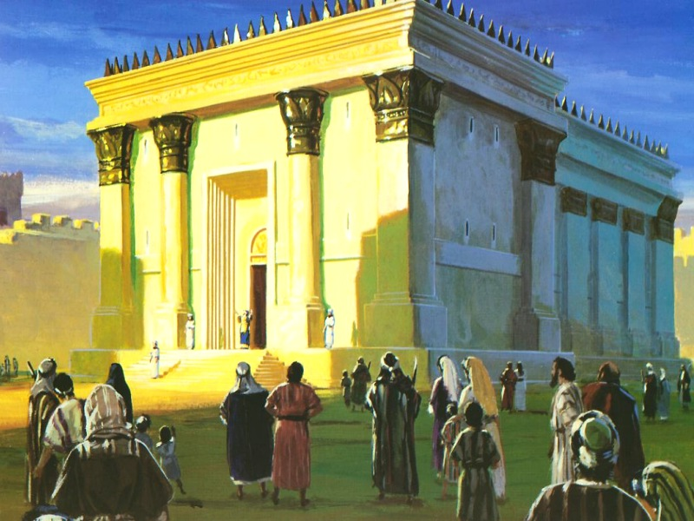
YOUR FUNERAL AND WHAT FOLLOWS…
WHAT WE WILL DO IS EARNED:
We Must Be Motivated to Work
We Will Only Have in Heaven What We Work for Down Here

Slide 20
LISTEN TO PAUL: “For we must all appear before the judgment seat of Christ; that every one may receive the things done in his body, according to that he hath done, whether it be good or bad.” 1 Cor. 5:10

Slide 21
LISTEN TO PETER: “And if ye call on the Father, Who without respect of persons judgeth according to every man’s work, pass the time of your sojourning here in fear.” 1 Peter 1:17

Slide 22
LISTEN TO JESUS: “Lay not up for yourselves treasures upon earth, where moth and rust doth corrupt, and where thieves break through and steal...

Slide 23
LISTEN TO JESUS: “But lay up for yourselves treasures in heaven...” Matt. 6:19,20

Slide 24
PARABLE OF THE WISE STEWARDS: Lk. 16:1-3 Shows the foolishness of God’s people in failing to prepare for the day of accounting they know is coming.

Slide 25
PARABLE OF THE TALENTS: Mt. 25:14-30 (5-2-1) Shows that while Christians have different opportunities, it is their faithfulness that will be rewarded.

Slide 26
PARABLE OF THE POUNDS: Lk. 19:11-27 10 Servants – 10 Pounds ($) 10 – 5 – 1 Shows that those with equal opportunity compete with each other & those serving w/ varying degrees of faithfulness receive different rewards.

Slide 27
PARABLE OF THE LABORERS: Mt. 20:1-16 6am – 9am – noon – 3pm – 5pm Shows that time is not a controlling factor in rewards for the believer.

Slide 28
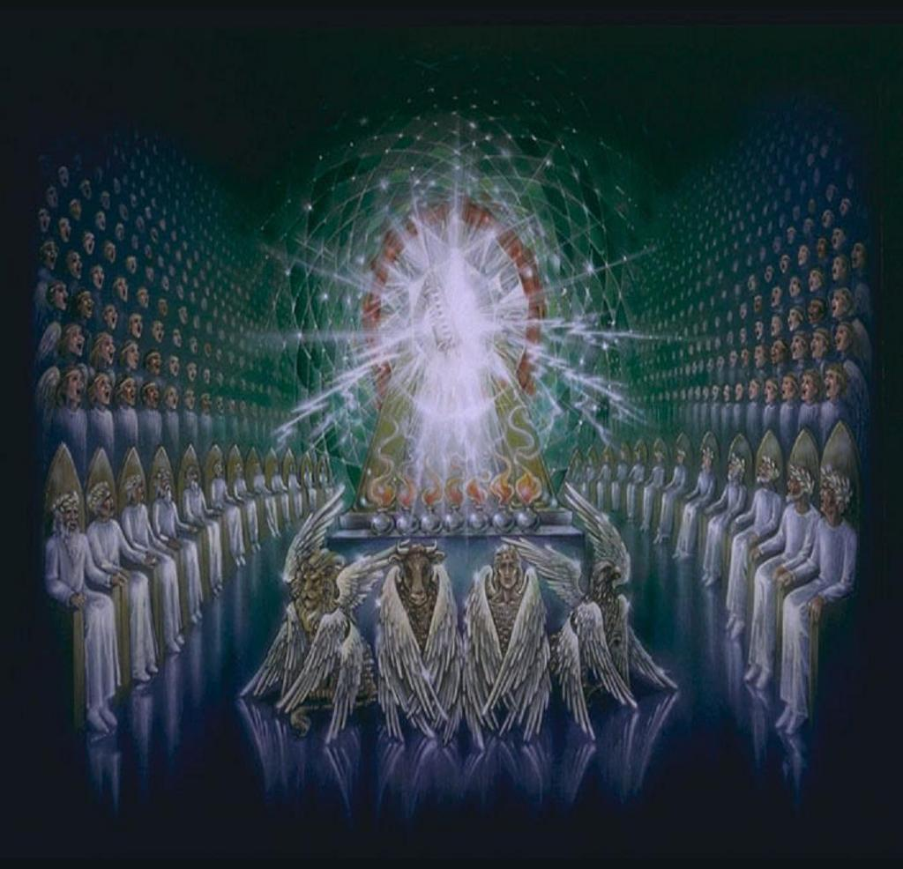
YOUR FUNERAL AND WHAT FOLLOWS
WHERE WE WILL BE IS FREE
WHAT WE WILL BE LIKE IS DEVELOPED
WHAT WE WILL DO IS EARNED

Slide 29
WHAT WILL YOU BE AND DO IN HEAVEN?
EVERYTHING DEPENDS ON YOU, HERE AND NOW!
HOW ARE YOU DOING?!

Slide 30
FINAL QUESTION:
Are YOU going to Heaven?

