Slide 1
Ruth: Romance & redemption
The Backslider’s Testimony

Slide 2

The Backslider’s Testimony
THE TEDIOUS TRIP:
Going Back Home:
Getting Back Home:

Slide 3
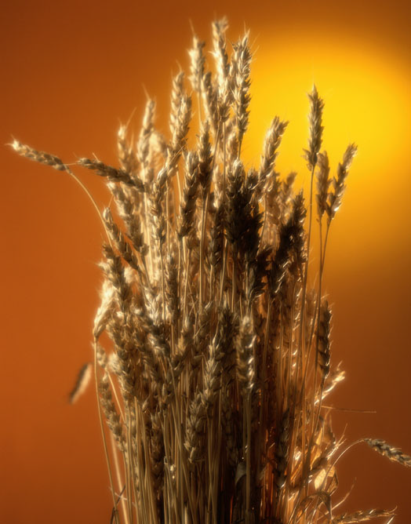
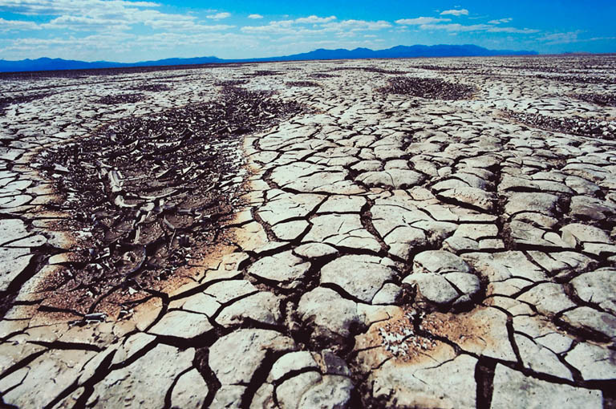
It is always “harvest time” in God’s will and “famine time” outside of it. The best time to return to the Lord is now! You too will find a warm welcome and a time of harvest waiting for you.

Slide 4
The Backslider’s Testimony
THE TRAGIC TALE:
The Backslider’s Co$t
The Backslider’s Condition: “Mara”

Slide 5

The Backslider’s Testimony
THE TEARFUL TESTIMONY:
The Backslider’s Contrition
The Backslider’s Complaint

