Slide 1
Pastor Gilmore and Asst. Pastor Bob Meyer welcome YOU to First Baptist Church

Slide 2
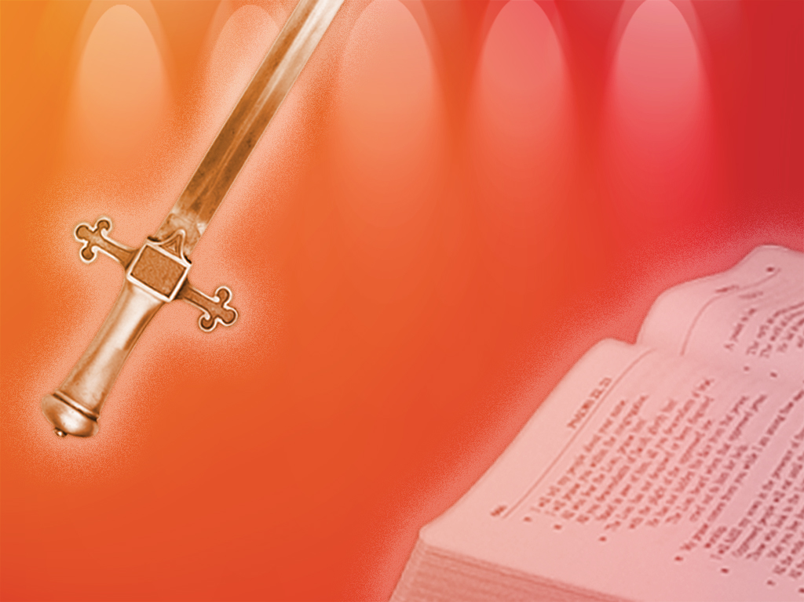
The King James Bible is the only book out of the 25 million plus books in the Library of Congress (or your library!) that doesn’t have a copyright!

Slide 3
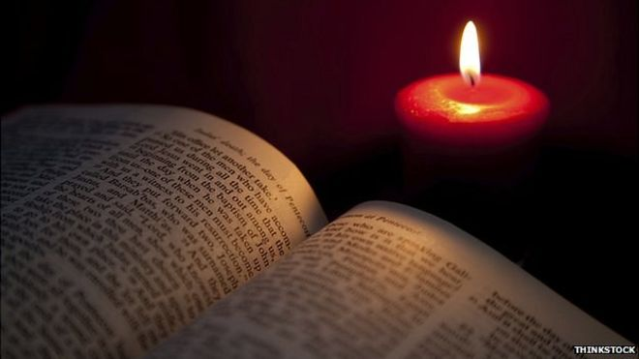
The King James Bible is the only translation of God’s Word in English that has a command to “study” it! (That includes the “New [NOT!] King James” Version!)

Slide 4
There can never be a “NEW King James Version” ! King James has been dead for a long time! Somebody is lying!

Slide 5
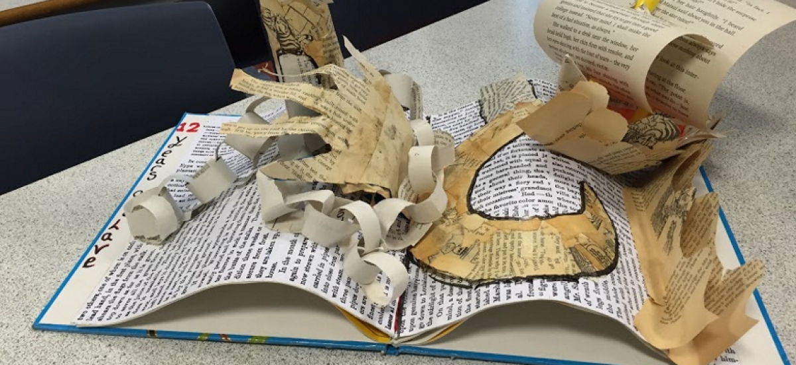
Their “NEW King James Version” is NOT “NEW”. It is a combination of the Revised Standard Version, the American Standard Version and the King James Bible.

Slide 6
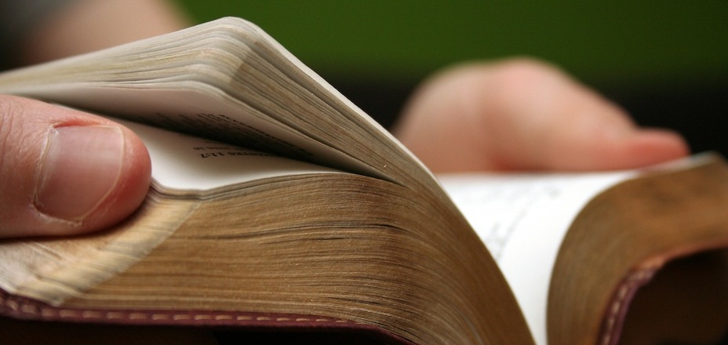
The King James Bible is the only translation of God’s Word in English that honors the Trinity in 1 John 5:7.

Slide 7
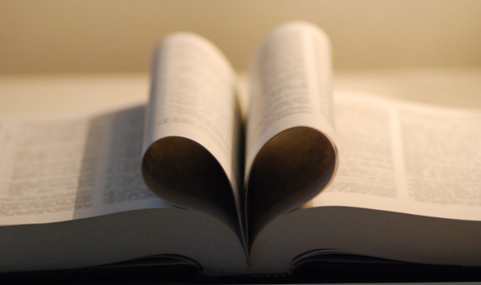
The King James Bible is the only translation of God’s Word in English that is translated from the Traditional Text of Scripture! (All others rely upon Roman Catholic texts – mainly Sinaiticus and Vaticanus in the N.T.)

Slide 8
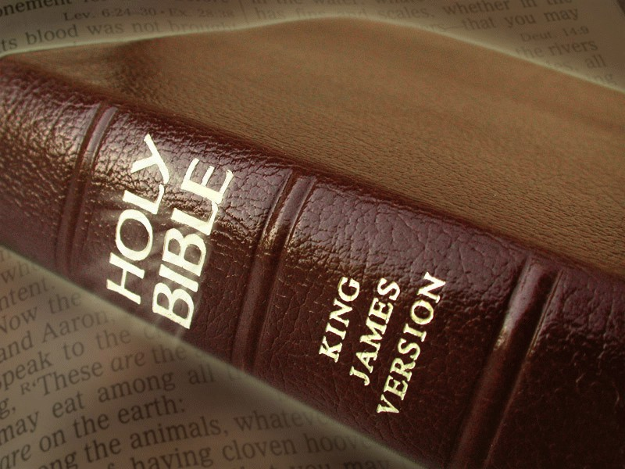
The King James Bible is the only translation of God’s Word in English that alerts you when the translators supplied words not in the Traditional Text by using italics!

Slide 9
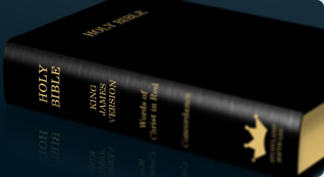
The King James Bible is the only translation of God’s Word in English that consistently gives the preeminent place to our Savior, the Lord Jesus Christ.

Slide 10
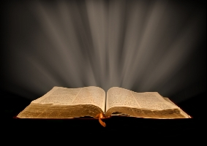
“Thy word is a lamp unto my feet and a light unto my path.” Ps. 119:105

Slide 11
Every true church must be built upon the firm foundation of God’s Holy Word.

Slide 12
“For the word of God is quick and powerful and sharper than any two-edged sword…”

Slide 13
Warning!
“For I testify unto every man that heareth the words of the prophecy of this book, If any man shall add unto these things, God shall add unto him the plagues that are written in this book:

Slide 14
“And if any man shall take away from the words of the book of this prophecy, God shall take away his part out of the book of life, and out of the holy city, and from the things that are written in this book.” Rev. 22:18,19

Slide 15
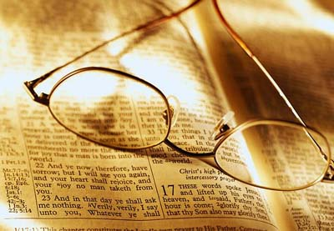
We trust YOU are growing in the grace (from the Living Word) and in the knowledge (from the Written Word) of our Lord Jesus Christ.

