Slide 1
BEFORE THE BEGINNING…
Romans 8:28-31

Slide 2
Romans 8:28-31’ Romans 8:28-31 And we know that all things work together for good to them that love God, to them who are the called according to his purpose. For whom he did foreknow, he also did predestinate to be conformed to the image of his Son, that he might be the firstborn among many brethren. Moreover whom he did predestinate, them he also called: and whom he called, them he also justified: and whom he justified, them he also glorified. What shall we then say to these things? If God be for us, who can be against us?

Slide 3
MARRIED…
1ST CHILD?
GENDER?
NAME?
COLOR FOR NURSERY?
CLOTHING?
FURNITURE?

Slide 4
HIS FOREKNOWLEDGE
(Stage #1)
The word means
“to know in advance”

Slide 5
Psalm 139:16 Thine eyes did see my substance, yet being unperfect; and in thy book all my members were written, which in continuance were fashioned, when as yet there was none of them.

Slide 6
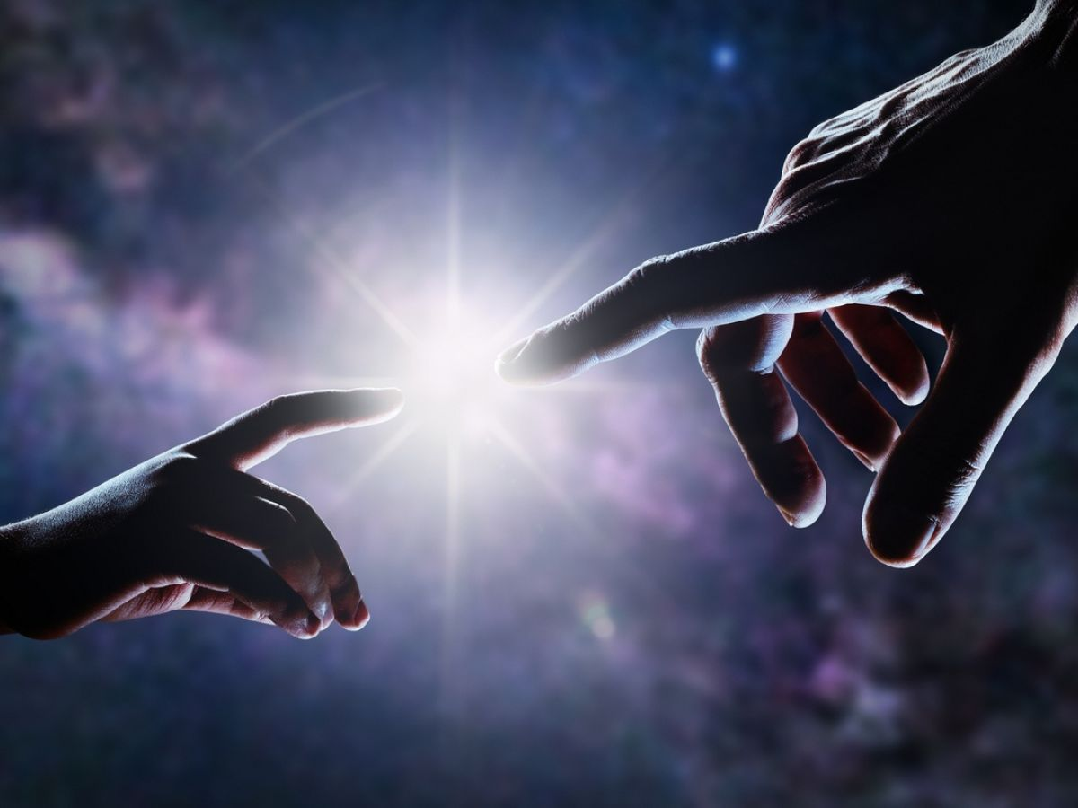
HIS PREDESTINATION
(Stage #2)
This is NOT the Calvinist’s Definition
“to be conformed to the image of His Son”
Predestined to be
“the firstborn…”

Slide 7
HIS CALLING:
(Stage #3)
God not only knows but He has a Plan
What is His plan for you?

Slide 8
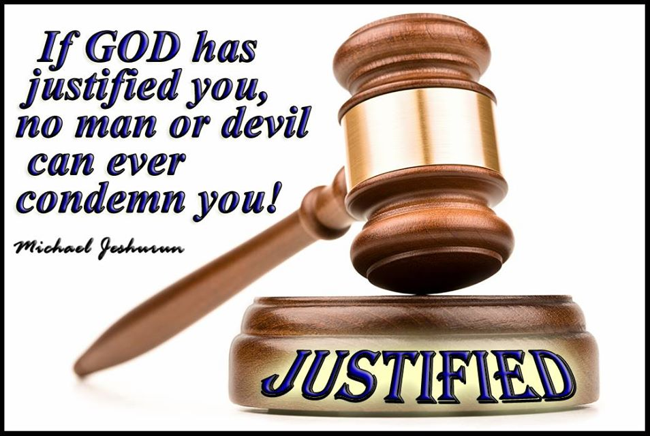
HIS JUSTIFICATION:
(Stage #4)
Our legal standing with God
God Justifies every
son whom He calls
v.31

Slide 9
OUR GLORIFICATION:
(Stage #5)
The Final Step in Our Salvation
God conforms every
son to his likeness!
“We shall be like Him”

